Slide 1

CYBER SECURITY VULNERABILITIES
UNIT 2

Slide 2
Topics to be covered
Overview, vulnerabilities in software
System administration
Complex Network Architectures
Open Access to Organizational Data
Weak Authentication
Unprotected Broadband communications
Cyber Security Safeguards.

Slide 3
Tools for Vulnerability Assessment
Manually testing might be a tedious job.
Automation tools include:
Simulation tools that test web applications.
Scanners that test network services and protocols.
Network scanners that identify malicious packets and defects in IP addresses.
Some prominent simulation tools and frameworks
Nessus
Type: Vulnerability Scanner
Description: Nessus is one of the most widely used vulnerability assessment tools. It scans systems for known vulnerabilities and provides detailed reports and remediation guidance.
Website: [Tenable Nessus](https://www.tenable.com/products/nessus)

Slide 4
Some prominent simulation tools and frameworks..
Qualys
Type: Cloud-based Vulnerability Management
Description: Qualys offers a range of security and compliance solutions, including vulnerability management, which provides continuous monitoring and assessment of security risks.
Website: [Qualys](https://www.qualys.com/)
OpenVAS
Type: Open-Source Vulnerability Scanner
Description: OpenVAS is part of the Greenbone Vulnerability Management (GVM) suite. It provides comprehensive vulnerability scanning and management.
Website: [OpenVAS](https://www.openvas.org/)
Burp Suite
Type: Web Application Security Testing
Description: Burp Suite is a popular tool for web application security testing, including vulnerability scanning and penetration testing.
Website: [Burp Suite](https://portswigger.net/burp

Slide 5
Some prominent simulation tools and frameworks..
Metasploit Framework
Rapid7 InsightVM
IBM Security Qradar
Cuckoo Sandbox
Threat Simulator
GVM (Greenbone Vulnerability Manager)

Slide 6
Advantages of Vulnerability Assessment:
Detect the weakness of your system before any data breach occurs.
A list of all possible vulnerabilities for each device present in the system.
Record of security for future assessments
Limitations of Vulnerability Assessment:
Some advanced vulnerabilities might not be detected.
Assessment tools might not give exact results.

Slide 7
System Administration and Vulnerabilities
Process of maintaining and improving the security of computer systems networks, and servers.
Sysadmins, are responsible for ensuring that systems are secure and can handle networking tasks.
Responsibilities
Security policies: Adhering to organizational security policies and procedures
Security threats: Identifying and mitigating cybersecurity threats
Vulnerability patching: Applying patches to operating systems and applications
Network traffic: Tracking network traffic and activity
Database backups: Performing database backups to protect user information
Security awareness: Promoting security awareness through training and education
System maintenance: Installing and maintaining systems, including hardware and software
Network issues: Identifying and fixing network issues
System testing: Testing computer systems and internet servers to improve them

Slide 8
Skills for system administration
Strong analytical and problem-solving skills
Excellent written and oral communication skills
Detail-oriented
Self-motivated
Ability to multitask
Continuous learner

Slide 9
Security Issues in System Administration
Default configurations and weak permissions
Inadequate logging and monitoring
Use of outdated software

Slide 10
Misconfigurations and Their Impact
Misconfigured firewalls and access controls
Unsecured APIs
Weak or hardcoded credentials

Slide 11
Common indicators of vulnerability to security misconfigurations:
Default settings not reviewed: Using default configurations without reviewing security settings, permissions and default credentials.
Lack of secure communication: Using unencrypted or weakly encrypted communication channels.
Weak or absent access controls: Allowing unauthorized access to sensitive functionality or data.
Failure to update or patch: Not applying necessary security updates or patches to the app or underlying components.
Improper storage of sensitive data: Storing sensitive data in plain text or weakly protected formats.
Insecure file provider path settings: a file content provider that was meant for internal application use is exposed to other apps or users, which could potentially compromise sensitive data or allow unauthorized access to application resources.
Exported activities: an activity that is meant for internal application use is exported and/or browsable, which exposes an additional attack surface.

Slide 12
Technical Impacts: Impact SEVERE
Security misconfigurations can have significant technical impacts on mobile apps, including:
Unauthorized access to sensitive data: Misconfigurations may allow attackers to access sensitive information, such as user credentials, personal data, or confidential business data.
Account hijacking or impersonation: Weak or misconfigured authentication mechanisms can lead to account takeover or impersonation of legitimate users.
Data breaches: Inadequate security configurations may result in data breaches, exposing sensitive data to unauthorized individuals.
Compromise of backend systems: Misconfigurations in the mobile app can provide attackers with a foothold to compromise the backend systems or infrastructure.

Slide 13
Business Impacts Impact SEVERE
Security misconfigurations can have severe business impacts, including:
Financial loss: Breaches resulting from security misconfigurations can lead to financial losses, including legal penalties, regulatory fines, and damage to the organization’s reputation.
Data loss or theft: Misconfigurations can result in the loss or theft of sensitive data, leading to legal and financial consequences.
Downtime and disruption: Exploitation of security misconfigurations can lead to app downtime, service disruption, or compromised functionality, affecting user experience and business operations.
Damage to brand reputation: Publicly disclosed security incidents can damage the organization’s reputation, leading to loss of customer trust and potential loss of business.

Slide 14
Mitigation Techniques
Least privilege access control
Regular system audits and hardening
Security training for administrators

Slide 15
Prevention for Security Misconfigurations
Secure default configurations: Ensure that default settings and configurations are properly secured and do not expose sensitive information or provide unnecessary permissions.
Default credentials: Refrain from using hardcoded default credentials.
Insecure permissions: Avoid storing application files with overly permissive permissions like world-readable and/or world-writable.
Least privilege principle: Request only the permissions necessary for the proper functioning of the application
Secure network configuration: Disallow cleartext traffic and use certificate pinning when possible.
Disable Debugging: Disable debugging features in the production version of the app.
Disable backup mode (Android): By disabling backup mode on Android devices, you prevent the inclusion of app data in the device’s backup, ensuring that sensitive data from the app is not stored in the device backup.
Limit application attack surface by only exporting activities, content providers and services that are necessary to be exported

Slide 16
Network Security
The fundamentals of networking security remain the same

Slide 17
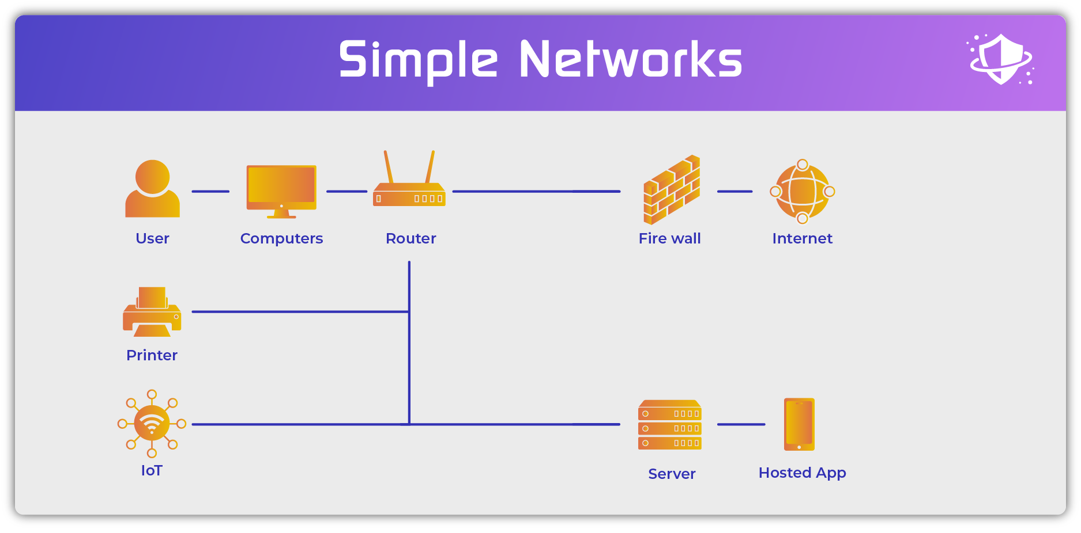

Slide 18
Followed a simple protocol:
Authenticate the user: using a computer login (username + password)
1
Check the user’s permissions: using Active Directory or a similar Lightweight Directory Access Protocol (LDAP)
2
Enable communication with authorized network resources (servers, printers, etc.)
3
Monitor local communications: using passive intrusion detection systems (IDS) or active intrusion prevention systems (IPS)
4
Monitor authorized and block unauthorized connections outside of the network: using firewalls
5

Slide 19
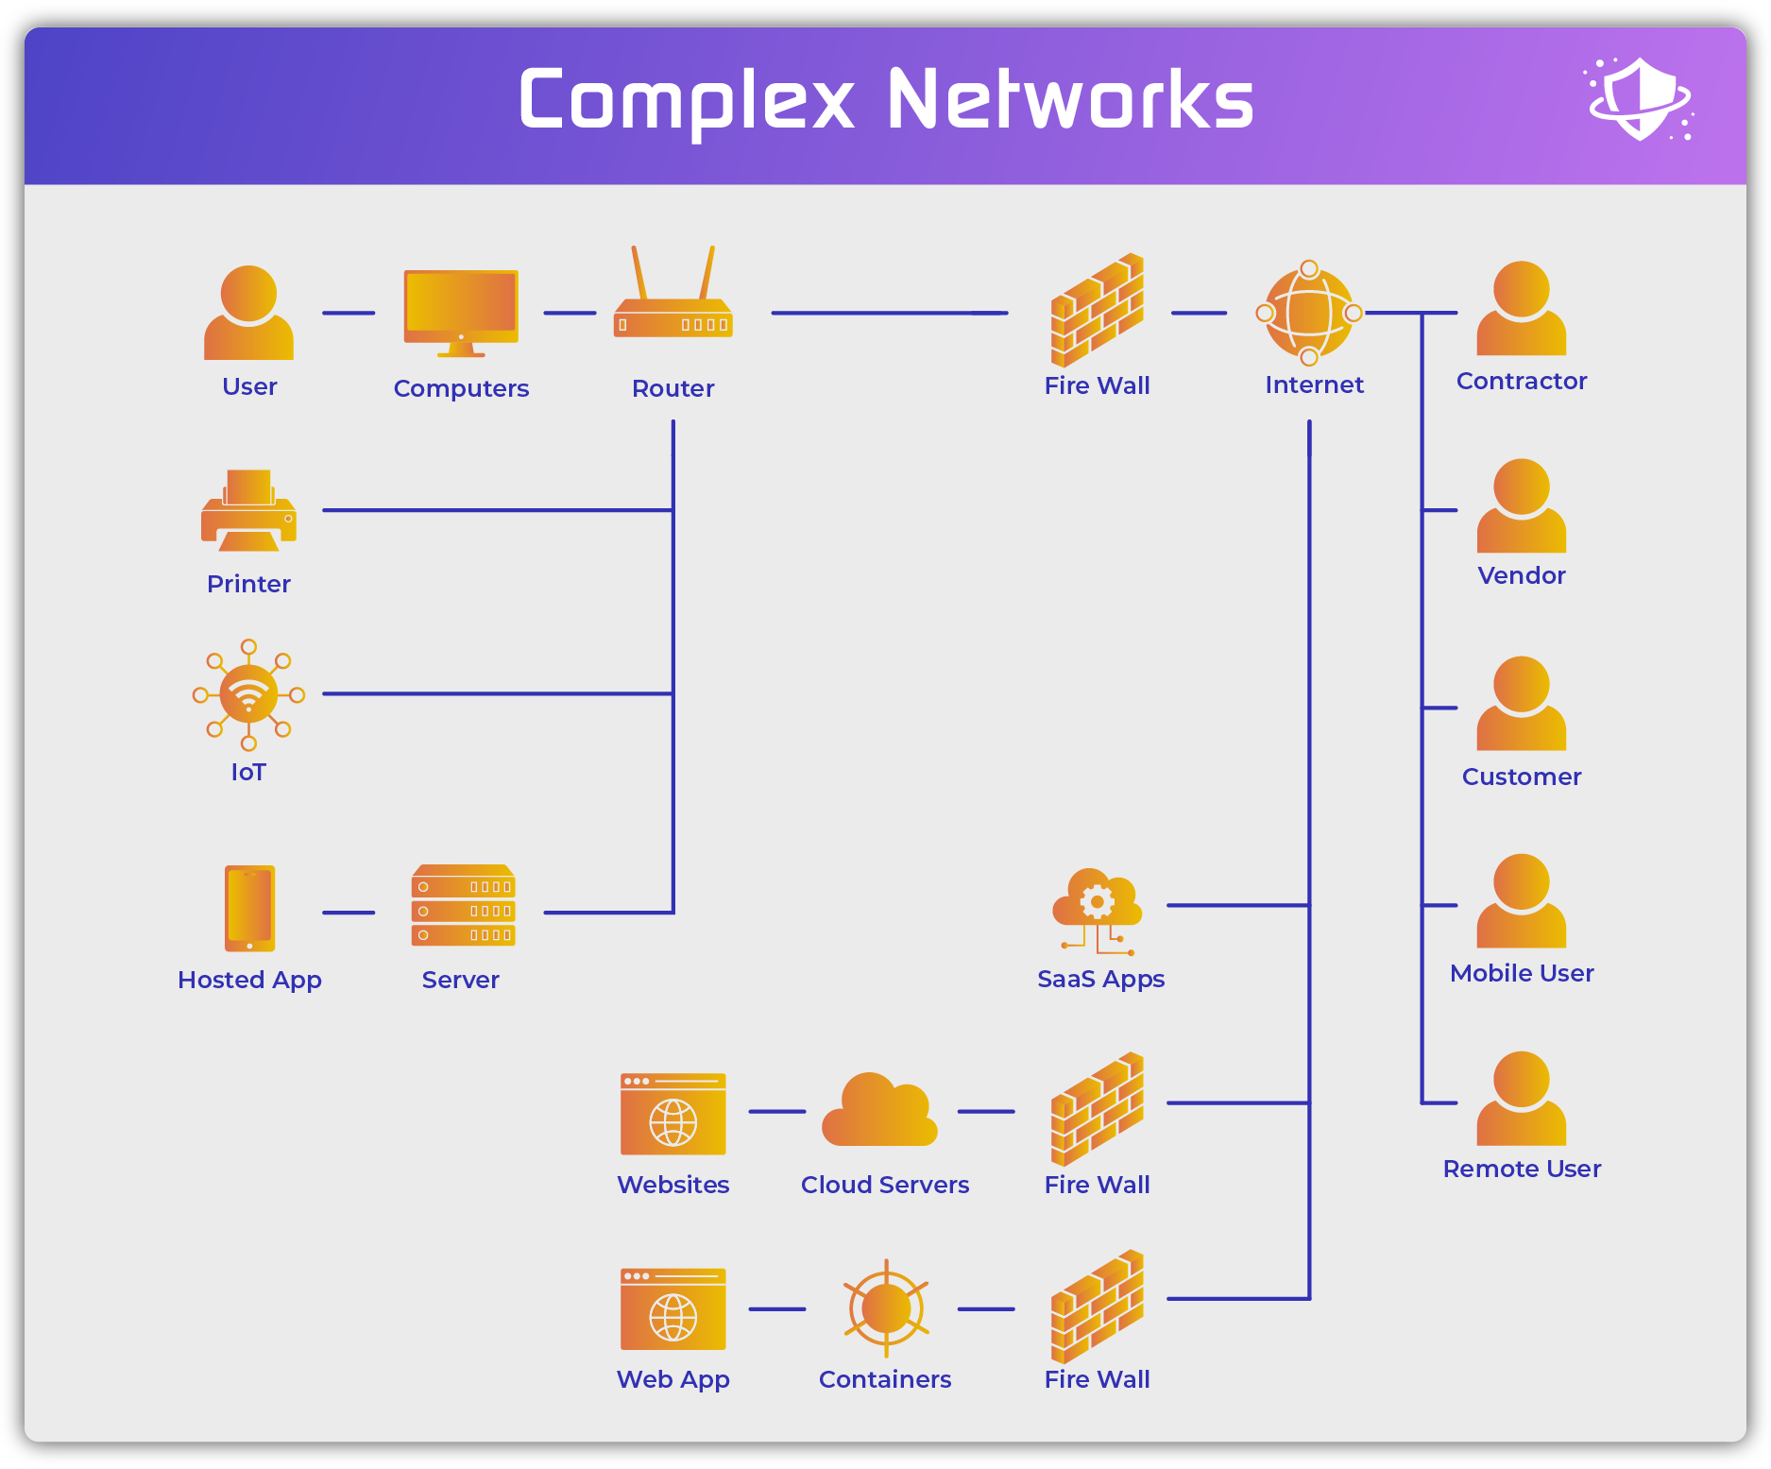

Slide 20
Newer Complex Networks
Users now encompass both local and remote employees. Vendors, customers, and contractors also frequently access resources within or directly connected to the network. Applications and services now act as users as well since they make active connections to devices, databases, and applications inside the network directly or through APIs.
Devices now consist of both corporate devices and uncontrolled BYOD devices consisting of computers, laptops, tablets, and mobile phones. Both virtual and physical servers, endpoints, and containers can be located in local data centers or remotely in branch offices or hosted in the cloud. The internet of things (IoT), operations technology (OT), and the industrial internet of things (IIoT) also now connect to networks.
Connections still encompass hard-wired physical switches and routers, but also now include wireless cellular networks, wi-fi networks, virtual networks, cloud networks, and internet connections.

Slide 21
Newer Complex Networks
Access points still require firewalls, but often include methods for external connections into the network such as virtual private networks (VPNs), remote desktop protocol (RDP) and network controllers for securing remote users using remote resources (secure gateways, secure access service edge (SASE), etc.).
Data now exists across the organization inside applications (databases, email, etc.), in cloud repositories (S3 buckets, data lakes, etc.), in Software-as-a-Service applications (CRM, file-sharing services, etc.), on mobile devices, home and international offices, and much more. Network security controls and tools should ideally shield, monitor, and secure the data in all of these environments.

Slide 22
Risks in Complex Network Structures
Increased attack surface
Poor segmentation and access control

Slide 23
Common Network Vulnerabilities
Unsecured protocols (HTTP, FTP, Telnet)
Misconfigured VLANs and firewalls
Lack of Network Access Control (NAC)

Slide 24
Mitigation Techniques
Network segmentation and Zero Trust Architecture (ZTA)
Secure network protocols (HTTPS, SSH, SFTP)
Intrusion Detection and Prevention Systems (IDPS)

Slide 25
Open Access to Organizational Data
Data Exposure Risks
Accidental public access to sensitive data
Improper data classification
Features | Data Exposure | Data Breach
Intent | Unintentional | Intentional
Underlying Factor | Human error, misconfigured systems, inadequate security | Deliberate attacks by cybercriminals or malicious actors
Impact | Can still lead to privacy violations and reputational damage | Often more severe impacts, including fraud and financial losses, identity theft, and disruption of operations
Solutions | Following security best practices, continuous monitoring and SecOps literacy | Robust security measures with discrete monitoring and alerting for anomaly detection and remediation

Slide 26
Common Vulnerabilities
Misconfigured cloud storage (AWS S3 Buckets, Google Cloud, Azure)
Insufficient access controls
Data leakage via unsecured endpoints

Slide 27
Types of Sensitive Data Exposure
Availability Breach
Occurs when authorized users are temporarily or permanently denied access to sensitive data.
e.g., Ransomware commonly uses this method to extort organizations.
Confidentiality Breach
Occurs when unauthorized entities access sensitive data, infringing upon its privacy and confidentiality.
The consequences can be severe. They can include financial fraud, identity theft, reputational harm, and legal repercussions
Integrity Breach
Occurs when unauthorized individuals or entities alter or modify sensitive data.
AI LLM training is particularly vulnerable to this breach form.
Compromises the data's accuracy and reliability.
This manipulation of data can result in misinformation, financial losses, and diminished trust in data quality. Vigilant measures are essential to protect data integrity. They also help reduce the impact of breaches.

Slide 28
Mitigation Techniques
Data encryption (at rest and in transit)
Role-Based Access Control (RBAC)
Regular audits and data loss prevention (DLP) tools

Slide 29

Weak Authentication Mechanisms

Slide 30
Common Weak Authentication Issues
Use of default credentials
Weak password policies
Lack of Multi-Factor Authentication (MFA)

Slide 31
Attacks Exploiting Weak Authentication
Brute force and dictionary attacks
Credential stuffing

Slide 32
Mitigation Techniques
Strong password policies
Implementation of MFA
Secure authentication mechanisms (OAuth, SAML, FIDO2

Slide 33
Secure authentication mechanisms like OAuth, SAML, and FIDO2 are protocols used to verify a user's identity when accessing online services, with each serving a distinct purpose
OAuth:
Primarily used for authorization, allowing third-party applications to access user data on a platform without requiring the user's full credentials, like when you log in to a website using "Sign in with Google"
SAML (Security Assertion Markup Language):
Primarily used for single sign-on (SSO) across multiple applications within an organization.
FIDO2 (Fast Identity Online):
A standard for passwordless authentication, enabling users to log in using biometric data or security keys registered on their devices.
It focuses on controlled access to specific resources rather than full user authentication
Where a user logs in once to access various services within their company network.
Eliminating the need to remember a password.

Slide 34

Unprotected Broadband Communications

Slide 35
Risks in Broadband Communications
Eavesdropping and interception
Wi-Fi vulnerabilities (Rogue APs, Evil Twin attacks)

Slide 36
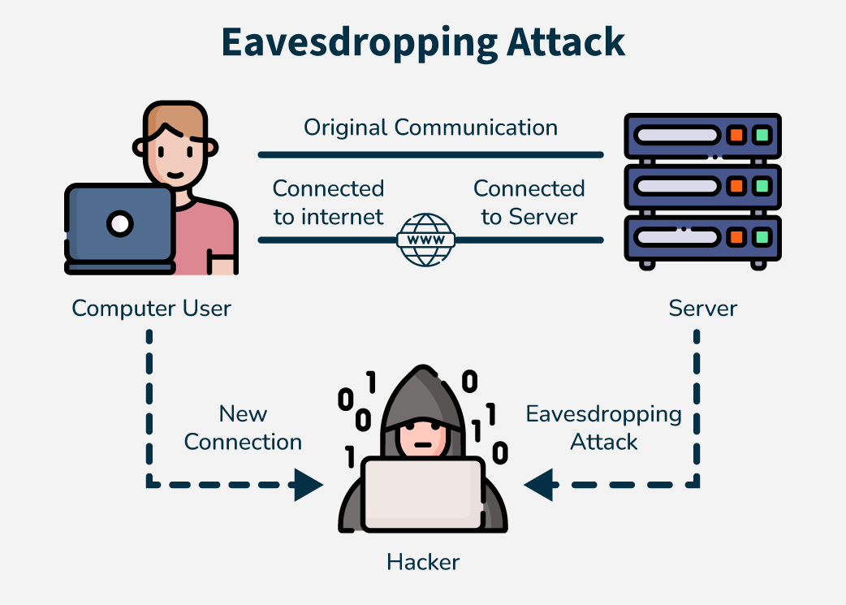
Eavesdropping and Interception
Also called sniffing or snooping attacks
Don’t raise any sort of alert
Example...
Results in financial loss, identity theft or privacy loss, etc.
Aspect | Active Eavesdropping | Passive Eavesdropping
Definition | Involves the attacker actively inserting themselves into the communication channel. | Involves the attacker silently listening to the communication without interfering.
Interaction | The attacker interacts with and can alter the communication. | The attacker does not interact with or alter the communication.
Detection | More likely to be detected due to the manipulation of data. | Harder to detect since there is no alteration of data.
Impact | Can lead to more severe consequences, such as data modification and fraud. | Primarily involves data theft without immediate disruption.
Example | A hacker intercepting and altering messages between two parties in a chat. | A person quietly listening to a confidential conversation in a public place.

Slide 37
Examples of Eavesdropping Attacks
Smart voice recognition assistants like Amazon Alexa and Google Home are also vulnerable to eavesdropping because of their “always-on” mode which is a big threat to users’ privacy.
Wireshark was a sniffing program that caused Android smartphone users a lot of trouble back in 2011. In this attack authentication tokens were sent all over an unencrypted Wi-Fi network which resulted in Wireshark viewing, stealing, modify and even deleting all the confidential data.
In 2015 even iOS suffered when over 25,000 iOS apps were vulnerable to eavesdropping attacks because of a bug in the open-source code library AFNetworking due to which HTTPS encryption could be taken down.

Slide 38
Wi-Fi vulnerabilities (Rogue APs, Evil Twin attacks)
Rogue Access Point
An unauthorized wireless access point without the owner's knowledge.
Evil Twin
A fake Wi-Fi network that mimics a legitimate one

Slide 39
Rogue APs
How it works: An unauthorized device, like a personal router, is connected to a network, creating a potential entry point for attackers to access sensitive data.
Impact: Can lead to data breaches, unauthorized network access, and potential malware distribution.
Detection: Network monitoring tools can identify rogue APs by detecting unknown SSIDs broadcasting in the area.

Slide 40
Evil Twin Attacks
How it works: A hacker sets up a fake Wi-Fi network with the same name (SSID) as a legitimate one, tricking users into connecting to the malicious network.
Impact: Once connected, the attacker can capture sensitive information like login credentials, credit card details, and browsing history.
Detection: Users can be cautious when connecting to public Wi-Fi networks, verifying the network name and checking for unusual signal strength.

Slide 41
Mitigation Techniques
VPN implementation
WPA3 for wireless security
Network traffic encryption

Slide 42
VPN implementation
Encrypts your internet connection
Hiding your IP address
Hide your online activity
From: hackers, ISPs, and government surveillance.

Slide 43
Key Benefits of Using a VPN
Enhanced Privacy: Prevents tracking and data collection by websites and third parties.
Secure Public Wi-Fi Use: Encrypts your connection to protect data from cyber threats.
Access Geo-Restricted Content: Unblocks streaming platforms like Netflix, BBC iPlayer, Hulu, and Disney+ from different regions.
Avoid Bandwidth Throttling: Prevents ISPs from slowing down your internet speed.

Slide 44
WPA3 for wireless security
WPA3-Enterprise lengthens the encryption to 192 bits (128-bit encryption in WPA3-Personal mode) to enhance password strength.
It protects against weak passwords that can be cracked relatively easily via guessing. Protect your network devices.

Slide 45
Network Traffic Encryption
Secures data in transit
Protecting it from unauthorized access
Utilize strong cryptographic techniques and protocols to prevent eavesdropping on network communications.
Mitigates Following Vulnerabilities:
Module Firmware AND System Firmware
Network Sniffing ( wired and/or wireless traffic)

Slide 46
Cybersecurity Safeguards
Preventive Measures
Detection and Response Strategies
Compliance and Legal Frameworks

Slide 47
Preventive Measures
Secure software development practices
Regular security assessments and audits

Slide 48

Secure software development practices
NIST Secure Software Development Framework (SSDF)
Prepare the Organization (PO): Ensure that an organization’s people, processes, and technology are prepared to perform secure software development at the organization level and, in some cases, for each individual project.
Protect the software (PS): Protect all components of the software from tampering and unauthorized access.
Produce Well-secured Software (PW): Software that has minimal vulnerabilities in its releases
Respond to Vulnerabilities (RV): Identify vulnerabilities in software releases and respond appropriately to address these vulnerabilities and prevent similar vulnerabilities from occurring in the future.

Slide 49
Secure software development practices
Each practice is defined with the following elements:
Practice: A brief statement of the practice, along with a unique identifier and an explanation of what the practice is and why it is beneficial.
Task: An individual action (or actions) needed to accomplish a practice.
Implementation Example: A given scenario that could be used to demonstrate a practice.
Reference: An established secure development practice document and its mappings to a particular task.

Slide 50
Regular security assessments and audits
Helps businesses to:
Identify and mitigate security Vulnerabilities and Risks
Ensuring Compliance with Regulations
Enhancing Security Measures and Protocols
Building Trust with Clients and Stakeholders
Optimizing IT Performance

Slide 51
Regular security assessments and audits
How to Implement Effective Security Audits
Establish a Regular Schedule
Use Comprehensive Assessment Tools
Engage with Professional IT Security Experts
Review and Update Continuously

Slide 52
Detection and Response Strategies
Security Information and Event Management (SIEM)
Incident Response Planning

Slide 53
Security Information and Event Management (SIEM)
Helps organizations analyze, detect, respond and remediate to security threats before they harm business operations.
Combines both security information management (SIM) and security event management (SEM) into one security management system.
Gives organizations visibility into activity within their network to Identify possible threat/attack.
Helps to meet compliance requirements.

Slide 54
SIEM capabilities
Log management
Event correlation
Incident monitoring and response

Slide 55
SIEM use cases
Detecting
Detecting suspicious user activity
Monitoring
Monitoring user behavior
Limiting
Limiting access attempts
Generating
Generating compliance reports.

Slide 56
Benefit of using a SIEM
A central view of potential threats
Real-time threat identification and response
Advanced threat intelligence
Regulatory compliance auditing and reporting
Greater transparency monitoring users, applications, and devices

Slide 57
What is the difference between security information management (SIM) and security event management (SEM)?
Security information management (SIM) is the process of collecting, storing, and monitoring event and activity log data for analysis. It is considered a broader, more long-term process.
Security event management (SEM) is the process of real-time monitoring and analysis of security events and alerts to address threats, identify patterns and respond to incidents. In contrast to SIM, it looks closely at specific events that may be a red flag.
SIEMs combine these two approaches into one solution.

Slide 58
Incident response planning
The process of creating a plan to respond to security incidents, such as data breaches or ransomware attacks.
Set of instructions to help IT staff detect, respond to, and recover from network security incidents.

Slide 59
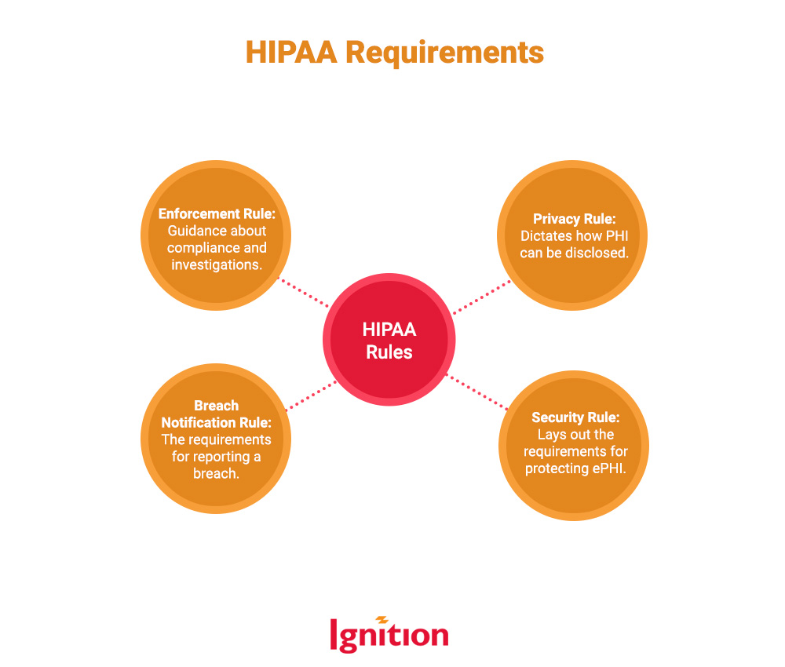
Compliance and Legal Frameworks
GDPR General Data Protection Regulation
HIPAA,Health Insurance Portability and Accountability Act (HIPAA)
ISO 27001 Information Security Management System (ISMS) Certification,
NIST Framework

